Slide 1
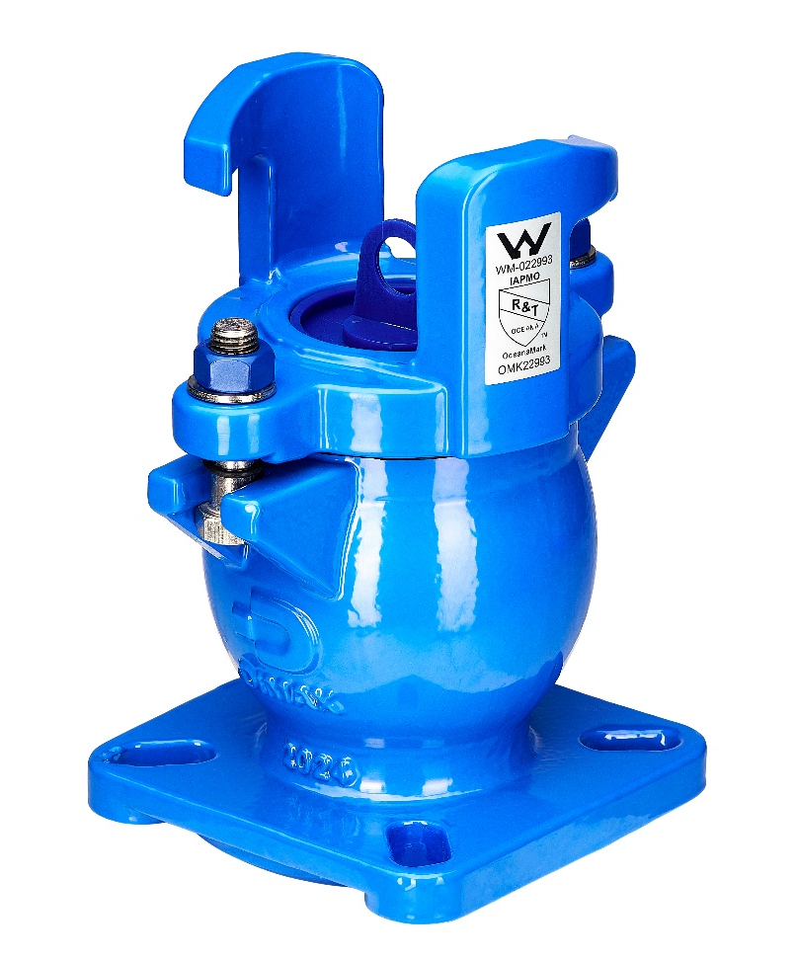




DIMAX SPRING HYDRANT VALVE
DN80-100 PN16 SPRING HYDRANT ASSEMBLY
FEATURES
Ductile iron body and bonnet for high strength and impact resistance
Fusion bonded polymeric coating for long life corrosion protection
Corrosion resistant components for long life operation
O-ring located on fasteners to ensure they remain in place when yoke is removed
Dust cap fitted to prevent ingress of dirt into seat area
Extra thick seat gasket to provide improved perforation resistance and reduce maintenance requirements
Removal of internal components to allow direct full-bore access to the pipeline for insertion and removal of swabs for scouring purposes
APPLICATION
TECHNICAL DATA
CERTIFICATIONS
DIMAX Spring Hydrant Valves provide direct access to water pipelines for fire fighting purposes. Access is gained by the attachment of a standpipe to the spring hydrant lugs.
The hydrant valve can also be used as a scouring and flushing point.
Size Range
DN80-DN100
Product Test Requirements
Seat Test = 1600kPa
Body Strength Test = 2400kPa
Working Temperature
Max. Design Temperature = 70°C
AS4020 Temperature = 40°C
IAPMO AS4795.1 OceanaMark License No WM-022993 OMK22993
AS/NZS 4020 – Testing for use in contact with drinking water
AS/NZS3952-2002 – Water Supply – Spring hydrant valve for waterworks purposes
Fusion bonded polymeric coating to AS/NZS 4158
Flange connections drilled to AS/NZS 4087
CALL 1800 032 566 or VISIT
www.reece.com.au/storefinder for your nearest branch

Slide 2
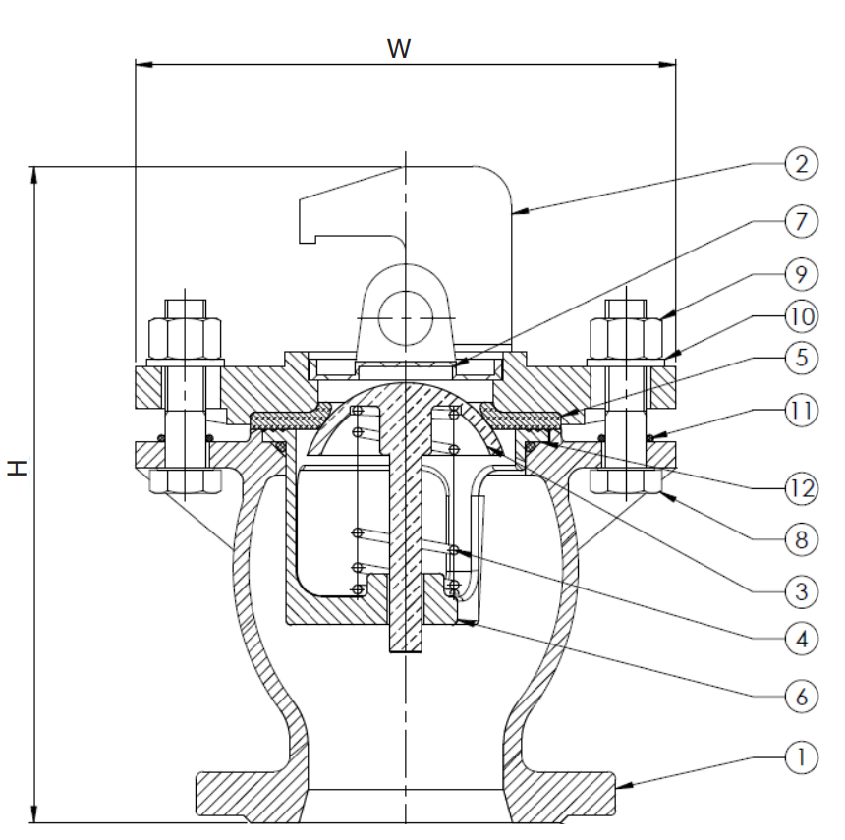
DIMAX SPRING HYDRANT VALVE
DN80-100 PN16 SPRING HYDRANT ASSEMBLY
LINE DRAWING 1
TABLE 1
 | DESCRIPTION | MATERIAL
1 | Body | SGI Grade 500-7
2 | Yoke | SGI Grade 500-7
3 | Dome | Brass C48600 to AS1568
4 | Spring | 304 Stainless Steel
5 | Resilient Seat | EPDM AS1646 Synthetic Rubber
6 | Spring Support | SGI Grade 500-7
7 | Dust Cover | LD Polyethylene
8 | Hex Head Bolt | AS2837 316 Stainless Steel
9 | Hex Nut | AS2837 316 Stainless Steel
10 | Washer | AS2837 316 Stainless Steel
11 | O-Ring | NBR AS1646 Synthetic Rubber
12 | O-Ring | EPDM AS1646 Synthetic Rubber
NO.
TABLE 2
DN | H mm | W mm | WEIGHT kg
80 | 255 | 210 | 8.5
100 | 255 | 210 | 9.5
80/100 SLOTTED | 255 | 210 | 9.5
CALL 1800 032 566 or VISIT
www.reece.com.au/storefinder for your nearest branch

Slide 3
DIMAX SPRING HYDRANT VALVE
DN80-100 PN16 SPRING HYDRANT ASSEMBLY
SPARE PARTS
DESCRIPTION | PRODUCT CODE
DIMAX SPRING HYDRANT YOKE ONLY BLUE | 1282160
DIMAX SPRING HYDRANT SPRING SUPPORT | 1282162
DIMAX SPRING HYDRANT SPARES KIT | 1282163
DIMAX SPRING HYDRANT DOME | 1282164
DIMAX SPRING HYDRANT SPRING (2) | 1282165
DIMAX SPRING HYDRANT EPDM RUBBER SEAT | 1282166
DIMAX SPRING HYDRANT DUST COVER | 1282167
DIMAX SPRING HYDRANT SS HEX BOLT M16x65 | 1282168
DIMAX SPRING HYDRANT SS HEX NUT M16 | 1282169
DIMAX SPRING HYDRANT SS WASHER | 1282170
DIMAX SPRING HYDRANT O-RING NBR 15x2.65 | 1282171
CALL 1800 032 566 or VISIT
www.reece.com.au/storefinder for your nearest branch

