Slide 1
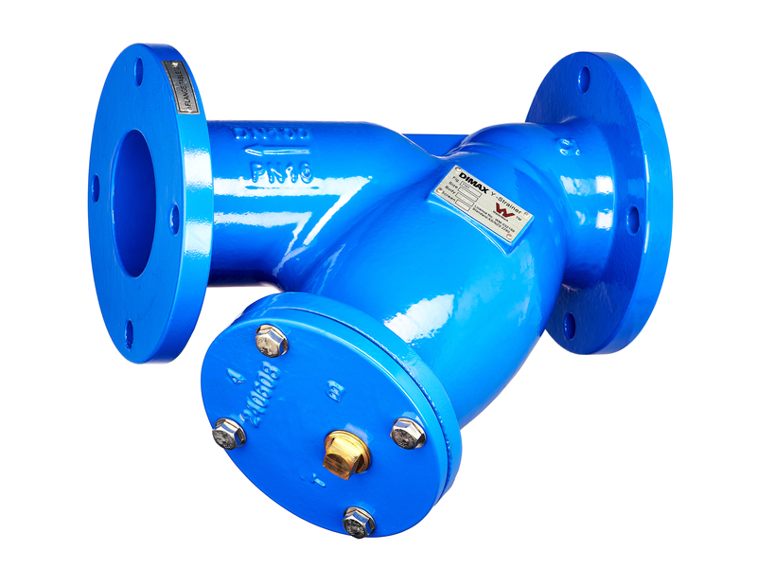




DIMAX Y-STRAINER
DN50-300 PN16 CAST IRON
FEATURES
Fusion bonded epoxy coating
Perforated 316 stainless steel filter screen with spot welded seam
Recessed body seat ensures accurate seat alignment
Removable cover for easy access to basket for cleaning
BSPT blowoff outlet on cover fitted with brass plug
Stainless steel fasteners
APPLICATION
TECHNICAL DATA
CERTIFICATIONS
DIMAX Y-Strainer enables scale and dirt residue to be caught, preventing the chance of damage to equipment. It is suitable for water and waste-water applications and allows full flow of liquid with only minimal pressure loss.
Size Range
DN50-DN300
Testing Pressure
2400kPa
Allowable Operating Pressure
1600kPa
Maximum Temperature
70°C
WaterMark AS4795.1 IAPMO-WM-032199
AS/NZS 2280 – Ductile iron pipe and fittings
Fusion bonded polymeric coating to AS/NZS 4158
Flange connections drilled to AS/NZS 2129 TE or optional TD AS/NZS 4087 PN16/35
CALL 1800 032 566 or VISIT
www.reece.com.au/storefinder for your nearest branch

Slide 2
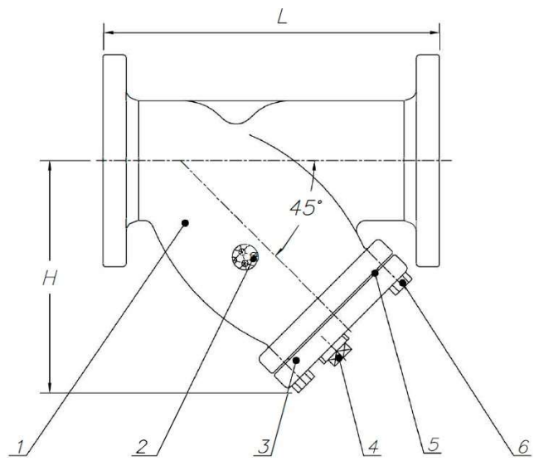
DIMAX Y-STRAINER
DN50-300 PN16 CAST IRON
LINE DRAWING 1
TABLE 1
 | DESCRIPTION | MATERIAL
1 | Body | JL-250 to AS830 Cast Iron
2 | Screen | ASTM A276 316 Stainless Steel
3 | Cover | C48600 to AS1568 Cast Iron
4 | Plug | C48600 to AS1568 DZR Brass
5 | Gasket | EPDM AS1646 Synthetic Rubber
6 | Bolt | ISO898 A4-70 Stainless Steel
NO.
TABLE 2
DN | CODE Table E | L mm | H mm | PLUG bsp | WEIGHT kg
50 | 1008650 | 230 | 176 | ½” | 8.5
65 | 1008651 | 273 | 202 | 1” | 12
80 | 1008652 | 295 | 220 | 1” | 16
100* | 1008653 | 352 | 256 | 1” | 25
125 | 1008654 | 416 | 332 | 1 ¼” | 37
150* | 1008655 | 470 | 370 | 1 ½” | 52
200 | 1008656 | 543 | 465 | 1 ½” | 89
250 | 1008657 | 660 | 532 | 2” | 145
300 | 1008658 | 770 | 616 | 2” | 192.5
*TABLE D AVAILABLE
CALL 1800 032 566 or VISIT
www.reece.com.au/storefinder for your nearest branch

Slide 3
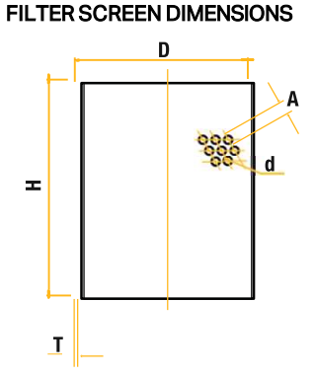
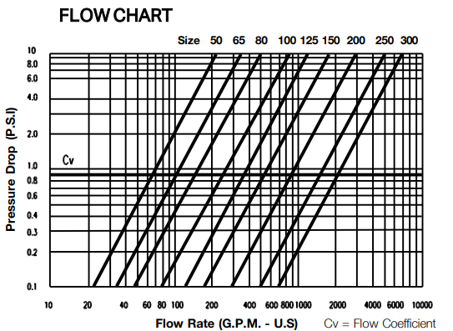
DIMAX Y-STRAINER
DN50-300 PN16 CAST IRON
FILTER SCREEN DIMENSIONS
FLOW CHARACTERISTICS CHART
TABLE 3
DN | D mm | H mm | A mm | d mm | T mm | FREE FLOW mm %
50 | 55 | 105 | 2.8 | 1.5 | 0.5 | 33
65 | 71 | 132 | 2.8 | 1.5 | 0.5 | 33
80 | 78.5 | 148 | 2.8 | 1.5 | 1.0 | 33
100 | 103 | 196 | 4.5 | 3 | 1.0 | 40
125 | 128 | 234 | 4.5 | 3 | 1.0 | 40
150 | 156 | 229 | 4.5 | 3 | 1.0 | 40
200 | 208 | 324 | 4.5 | 3 | 1.0 | 40
250 | 263 | 388 | 4.5 | 3 | 1.0 | 40
300 | 314 | 412 | 4.5 | 3 | 1.0 | 40
CALL 1800 032 566 or VISIT
www.reece.com.au/storefinder for your nearest branch

Slide 4
DIMAX Y-STRAINER
DN50-300 PN16 CAST IRON
SPARE PARTS
DESCRIPTION | PRODUCT CODE
DIMAX/DURA Y-STRAINER FILTER 316 50MM | 1009270
DIMAX/DURA Y-STRAINER FILTER 316 65MM | 1009271
DIMAX/DURA Y-STRAINER FILTER 316 80MM | 1009272
DIMAX/DURA Y-STRAINER FILTER 316 100MM | 1009273
DIMAX/DURA Y-STRAINER FILTER 316 125MM | 1009274
DIMAX/DURA Y-STRAINER FILTER 316 150MM | 1009275
DIMAX/DURA Y-STRAINER FILTER 316 200MM | 1009276
DIMAX/DURA Y-STRAINER FILTER 316 250MM | 1009277
DIMAX/DURA Y-STRAINER FILTER 316 300MM | 1009278
DIMAX SPARE Y-STRAINER GASKET EPDM 50MM | 9512590
DIMAX SPARE Y-STRAINER GASKET EPDM 65MM | 9512591
DIMAX SPARE Y-STRAINER GASKET EPDM 80MM | 9512592
DIMAX SPARE Y-STRAINER GASKET EPDM 100MM | 9512593
DIMAX SPARE Y-STRAINER GASKET EPDM 125MM | 9512594
DIMAX SPARE Y-STRAINER GASKET EPDM 150MM | 9512595
DIMAX SPARE Y-STRAINER GASKET EPDM 200MM | 9512596
DIMAX SPARE Y-STRAINER GASKET EPDM 250MM | 9512597
DIMAX SPARE Y-STRAINER GASKET EPDM 300MM | 9512598
CALL 1800 032 566 or VISIT
www.reece.com.au/storefinder for your nearest branch

